Slide 1
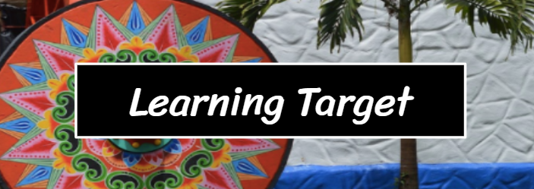
M1 U1 L02 Establish Reading Routines
I can find the gist of the chapter 1 excerpt of Summer of the Mariposas.
I can determine the difference between academic and domain-specific vocabulary.
(Craft & Structure LTa)

Slide 2
Agenda:
Today We Will: Opening A. Launch Vocabulary Logs B. Engage the Learner C. Reflect on the Module Guide Questions Work Time A. Read aloud and Identify Vocabulary: Summer of the Mariposas, Chapter 1 Excerpt B. Find the Gist Closing and Reflecting: Reflect on Learning Targets Homework: Preread Summer of the Mariposas, Chapter 2

Slide 3
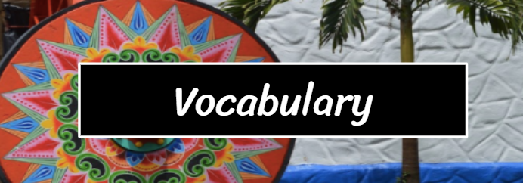
Domain-Specific Vocabulary:
Cadaver - a body
Predicament - a difficult, unpleasant, or embarrassing situation
Chastised - to discipline or punish, especially by beating
Resolutely - in an admirably purposeful. determined, and unwavering manner
Agonizing - causing great physical or mental pain

Slide 4
Academic vs. Domain Specific Vocabulary

Slide 6
Can you define the following two academic vocabulary words...gist and determine
Let's refer to our Learning Targets:
I can find the gist of the chapter except of Summer of the Mariposas.
I can determine the difference between academic and domain-specific vocabulary.
Gist is what the text is mostly about
Determine is to find out or establish exactly, typically as a result or research or calculation.

Slide 8
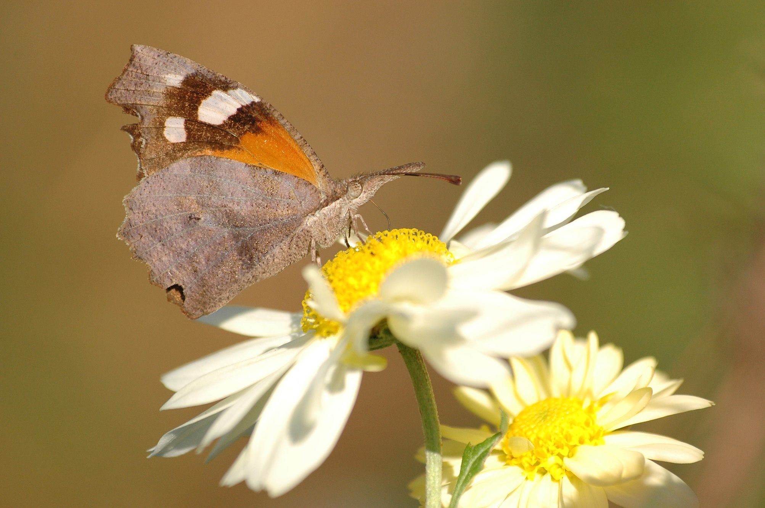
Transformation Mariposa (mah-ree-PO-sah)

Slide 9
Mariposa (mah-ree-PO-sah)
Butterfly in Spanish. Mariposas are slender, delicate insects with four wide, colorful wings. In almost every culture, butterflies are associated with transformation.
The Aztecs held the butterfly, papalotl, in high regard and had a special celebration to welcome the migrating monarchs in early August every year. They believed that mariposas were the cheerful souls of their loved ones, the angels of women and children, their fallen warriors, their ancestors, returning home transformed to assure them that they were well and the life, however brief, was beautiful.

Slide 10
What do you think the butterflies will symbolize in this text?

Slide 11
Gist of Chapter 1
Next you are going to listen to an excerpt of chapter 1. What is the gist of the excerpt? Listen for the following domain-spacific vocabulary...

Slide 12
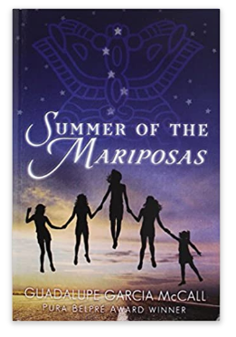
Summer of the mariposas
Prologue - Synopsis
A yearlong drought ended and with the rains came swarms of American Snout butterflies.
The reader is introduced to the five Garza girls.
Papa has been gone for a year, and Mama started a job.
The sisters are wild and restless all summer.
They find a swimming hole on the Rio Grande and visit it frequently.
Chapter 1
Please follow along in your text as we read chapter 1 of Summer of the Mariposas.
Learning Target: I can find the gist of the chapter 1 excerpt of Summer of the Mariposas.

Slide 13
Let's refer to out Learning Target:
I can find the gist of the chapter 1 excerpt of Summer of the Mariposas.
A synopsis restates all of the key events. A Gist is even more brief. It condenses all the central ideas into a short statement.
Synopsis: Summer of the Mariposas Prologue and Chapter 1
Chapter 1
The sisters find a drowned man's body in the river.
They argue about what to do with him.
They consider going to the authorities , leaving him, taking him to his family, or moving him.
They decide they need to return the drowned man's body to his family, but Odilia resists this plan.
What happened? What are the main events? How is the plot unfolding?
What is this section mostly about?
Remember to sum it up in one to two complete sentences.

