Slide 1
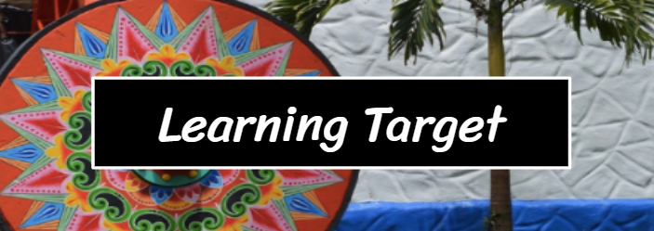
M1 U1 L04
Chapter 3
I can find the gist of chapter 3.
I can explain what effect is created by differences in the points of view of the characters and the reader in the chapter 3 excerpt of Summer of the Mariposas.
(Key Ideas & Details LTa and Craft and Structure LTc)

Slide 2
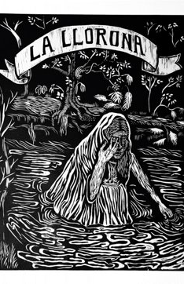
Follow along as we read Chapter 3, pages 44-58.
Chapter 3 Vocabulary
Immaculate - perfectly clean, flawless
Inexplicably - in a way that cannot be explained or accounted for
Penance - voluntary self-punishment inflicted as an outward expression of repentance for having done wrong
Ominous – threatening
Apparition - a ghost

Slide 3
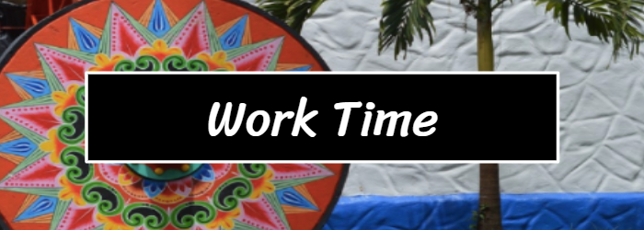
Learning Target: I can find the gist of the chapter 3 excerpt of Summer of the Mariposas.
Synopsis: Summer of the Mariposas Chapter 3
While the sisters load the drowned man’s body in their car, Odilia is visited by La Llorona.
La Llorona is an apparition whose children have drowned and who guards other children as penance.
La Llorona tells Odilia to take the dead body to Mexico. La Llorona also declares that she will protect the girls on the upcoming journey, and help Odilia find her way.
La Llorona gives Odilia a magical Aztec ear pendant as protection.
Turn to page 12 in your workbook. Record your gist of chapter 3. *Remember, a gist is a single sentence that states the main idea of the chapter.

Slide 4
I can identify strategies to determine (figure out) the meaning of unfamiliar vocabulary. (Vocabulary LTa)
One strategy is to use word parts: roots and affixes (prefixes and suffixes).
The root of the word gives the main meaning.
A prefix comes before the root
A suffix comes after the root.
Example: rereading
re = again
read = to look at and understand text
-ing =an ongoing action
When we are rereading something, we are reading it again right now.

Slide 5
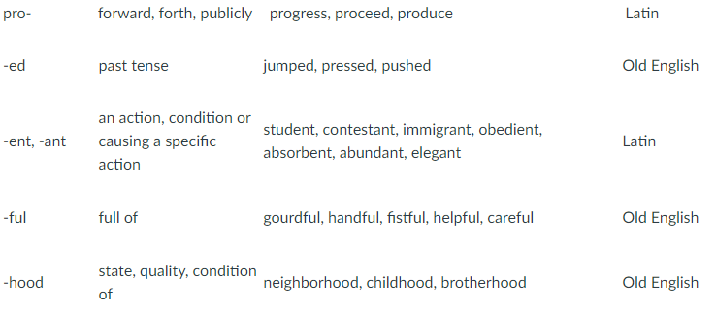
Here are just a few common prefixes and suffixes

Slide 6
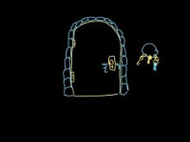
What do we mean by “word parts”?

Slide 7
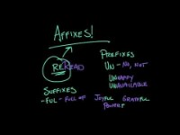
Affixes
Prefix – before
Suffix - after

Slide 8
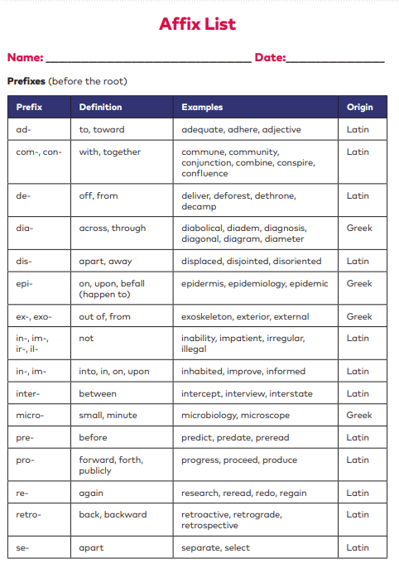
Each of you has your very own Affix List found on pages 216-221
Let’s use our list to explore some words.
Amorous
Root = amo which means:
Suffix = ous which means:
Therefore, amorous must mean:

Slide 9
Each of you has your very own Affix List found on pages 216-221
Let’s use our list to explore some words.
If someone goes to an arboretum, they are most likely going to look at what?
What does the root arbor mean?

Slide 10
Each of you has your very own Affix List found on pages 216-221
Let’s use our list to explore some words.
Divide the word inaudible into its parts.
prefix = which means:
root= which means:
suffix= which means:
Based on these word parts, inaudible must mean what?
If a person were an auditory learner, what could that mean?

Slide 11
Each of you has your very own Affix List found on pages 216-221
Let’s use our list to explore some words.
Sometimes a word has 2 roots or base words. What 2 roots make up the word hydrophobia?
root= which means:
root= which means:
Based on these word parts, hydrophobia must mean what?

