Slide 1
M1 U1 L08
Chapter 6: Figurative Language

Slide 2
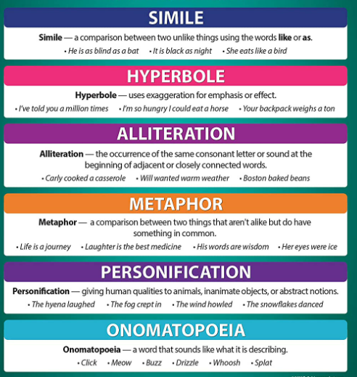
I can determine the meaning of figurative language in Summer of the Mariposas.
(Craft & Structure LTa and Vocabulary LTa)
Figurative: a word of phrase that has a deeper meaning than its basic meaning; not literal

Slide 3
Here’s what we missed in chapters 4 & 5…
Synopsis: Summer of the Mariposas Chapter 4
The girls drive Papa’s car into Mexico.
Odilia decides to believe in the cinco hermanitas, herself and her sisters, and their mission, instead of fighting with them about it.
Odilia uses her ear pendant to distract the border attendant so that the girls can pass safely over the border.
They cross the border into Mexico without the border guards suspecting they are carrying a corpse and keep driving.
Synopsis: Summer of the Mariposas Chapter 5
The girls bribe an officer to be allowed past a checkpoint.
Pita is nervous about being away from home and protests that she is being kidnapped and wants to return home.
Pita’s complaints cause the girls to fight.
While Odilia goes to the store to get food for the girls, the other sisters tie Pita to a tree.
Odilia returns and defends Pita.
They eat and rest in a secluded area.

Slide 4
Let’s read Chapter 6.
Turn to page 83 in your book.
Cryptic - having a meaning that is mysterious or obscure
Decipher - to succeed in understanding, interpreting, or identifying (something)
Quinceanera - (in Latin America and among Latinos) a celebration of a girl's fifteenth birthday and her transition from childhood to adulthood, typically involving a mass followed by a party
Disillusioned - disappointed in someone or something that one discovers to be less good than one had believed
Rigor Mortis - the stiffening of the body after death

Slide 5
Figurative Language

Slide 6
Turn to page 32 in your workbook.
Let’s explore our learning target together: I can determine the meaning of figurative language.

