Slide 1
M1 U1 L09
I can identify themes in A Long Walk to Water and how they have developed over the course of the text. (Key Ideas & Details LTa, LTb)
I can identify the characteristics of an effective summary. (Key Ideas & Details LTa, LTb)

Slide 2
I can identify themes in A Long Walk to Water and how they have developed over the course of the text. (Key Ideas & Details LTa, LTb)
I can identify the characteristics of an effective summary. (Key Ideas & Details LTa, LTb)
For your End of Unit 1 Assessment, you will be asked to do 2 things: Analyze a theme developed throughout our text and write an objective summary over a chapter. Today we are going to explore how you would go about doing these 2 tasks.

Slide 3
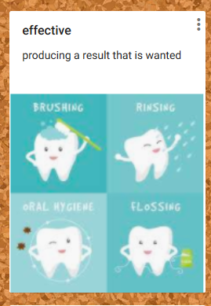
Learning Target: I can identify themes in A Long Walk to Water and how they have developed over the course of the text.
Learning Target: I can identify the characteristics of an effective summary.

Slide 4
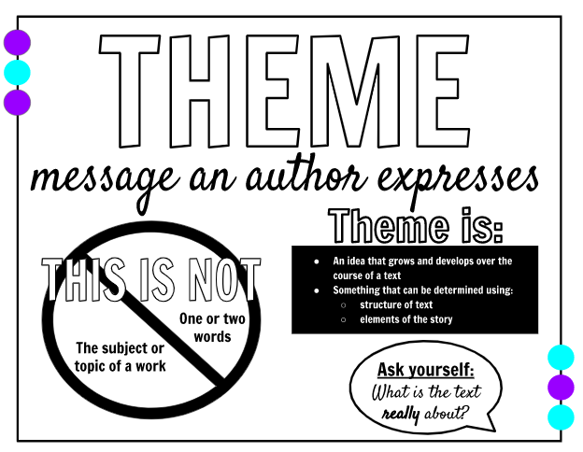
What do we mean by “theme”?
A theme is a message or lesson about life that the author wants the reader to take away from reading a literary text. It is a statement, not just a topic.

Slide 5
How do we find a theme?

Slide 6
Let’s explore some common themes in literature
Turn to page 38 in your Unit 1 Workbook.
Learning Target: I can identify themes in A Long Walk to Water and how they have developed over the course of the text.

Slide 7
Learning Target: I can identify the characteristics of an effective summary.
How to write a summary: Follow these steps...It's easier than you think!
Introduce the text by stating the title and chapter; clearly state the author’s central idea (gist).
Be objective - Don’t include your opinion. Exclude words like, “I think, or I believe.” Take yourself out of the summary. Give only details about the text.
Introduce the most important details from the text to show support of the central ideas and themes.
Be concise- don't ramble, get to the point!
Conclude your summary with a theme--make sure to include your theme before ending your summary.
Let’s look at an example on page 39 of your Unit 1 workbook.

