Slide 1
Analyzing the development of theme & writing an objective summary
Module 1
Unit 1
Lesson 10

Slide 2
I can identify how themes in A Long Walk to Water have developed in chapter 7. (Key Ideas & Details LTb)
I can write an objective summary of chapter 7. (Key Ideas & Details LTb)

Slide 3
Learning Target: I can identify how themes in A Long Walk to Water have developed in Chapter 7.
Let’s revisit our Common Themes in Literature from page 38.
1. Nature can present many challenges to humans.
2. Family is our most important support.
3. Love is what makes life worth living.
4. Dangerous situations can make people become leaders.
5. To be truly happy, you must do what you know is right, even if it is unpopular.
6. Individuals are able to survive in challenging environments in remarkable
ways.
7. People need to depend on one another in order to survive.
8. In challenging situations, it can be helpful to focus only on small steps.
As we reread chapter 7, think about which of these themes continues to develop in our story.

Slide 4
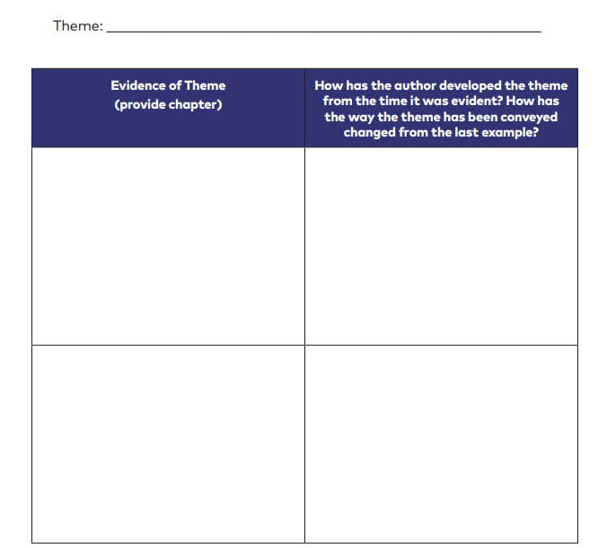
How does the author develop a theme throughout a text?
Turn to page 44 of your Unit 1 Workbook. Let’s work together to analyze how a theme develops over time.

Slide 5
Let’s review the components of an objective summary. What is our success criteria?
introduces the text by stating the title and chapter; clearly states the author’s central idea
Chapter 6 of A Long Walk to Water shows Nya and Salva struggling to survive dangerous environments. Both of their families help them, but sometimes this is not enough. Nya and her family have moved to a lake camp where life is difficult. Nya struggles to get water. She also realizes that her mother is afraid that the men in the family will become involved in the fighting near the camp. This shows how her mother is protective of the family. In Salva’s section, the struggle to survive continues. Salva’s uncle shoots an antelope for the group to eat. It is their first real meal in a long time, so it makes them sick. The group wanders a long time looking for water before going to sleep. When Salva wakes, his uncle tells him he has some bad news about his friend. Nya’s and Salva’s struggles show that even when people work together, nature can be overpowering.
The summary includes only the most important details from the text to show support of the central ideas and themes (stay objective: tell facts, not personal opinions or feelings)
Conclude with a theme statement.

Slide 6
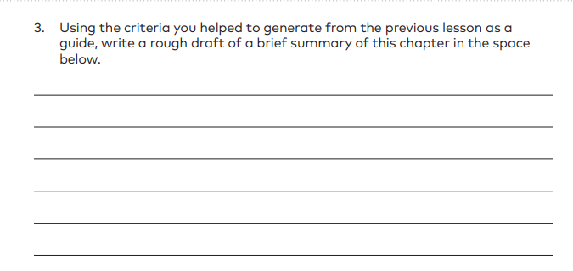
Learning Targets:
I can identify how themes develop in a text. I can write an objective summary.
On page 46 of your workbook, let’s work together to write an objective summary over chapter 7. We can use your synopsis on page 37 to help us.
Success Criteria:
Introduce book title, chapter and central idea
Only include the most important events
Conclude with a theme that is developed
Synopsis: A Long Walk to Water, Chapter 7
Akeer is dangerously ill with a bad stomachache, fever, cramps, and
diarrhea that can kill children and the elderly.
Nya’s family struggles with the decision of whether or not to travel with
Akeer on the long three-day walk to clinic.
While sleeping, Marial was killed by a lion, leaving only a few splotches of
blood as evidence.
Salva’s uncle calms and reassures Salva about the lions.
Soon they reach the Nile river and weave together reeds to make shallow
canoes to cross it.
After that, they’ll head through the desert and on to Ethiopia.

